Slide 1
ASDS 6302 final project
Analysing biomarkers to diagnose liver cirrhosis, and investigating for bias in healthcare algorithms.
Utkarsh Pant
1002170893

Slide 2
Introduction & problem statement
What is the Indian Liver Patient Dataset?
Causes of bias in the ILPD.
Project aim: examine the effect of modeling using the ILPD.

Slide 3
Methodology / Execution plan
Dataset overview
Univariate analysis -> distribution of each feature
Multivariate analysis -> pairwise correlation
Data preprocessing -> handling missing values, label encoding features, imputing outliers, scaling
Train/test set preparation -> 70% training, 30% test
Model training -> Logistic Regression, SVM
Comparing metrics -> Accuracy, ROC, AUC
Conclusions

Slide 4
Methodology / Execution plan: Dataset overview
10 features -> 9 continuous, 1 categorical
1 target -> Liver cirrhosis diagnosis, positive or negative
578 instances/rows

Slide 5
Methodology / Execution plan: Dataset overview
Continuous features -> Age, Total bilirubin, Direct bilirubin, Alkaline phosphatase, Alamine Aminotransferase, Aspartate Aminotransferase, Total proteins, Albumin, Albumin & Globulin Ratio
Categorical feature -> Gender
Target -> Selector

Slide 6
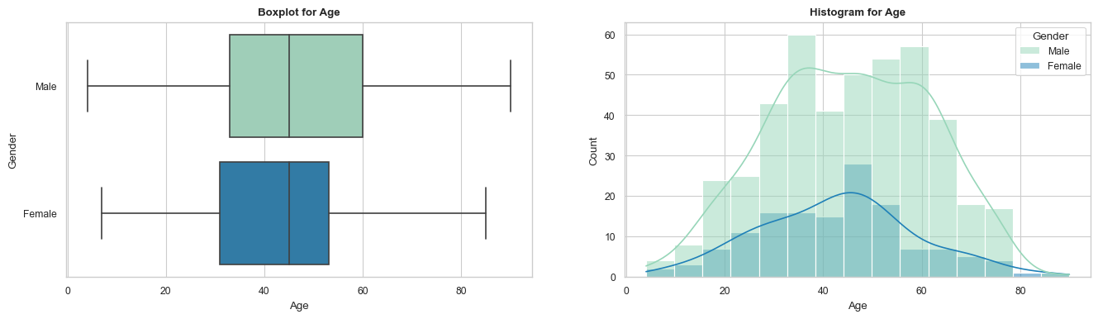
Methodology / Execution plan: Univariate analysis
Age -> 4 to 90

Slide 7
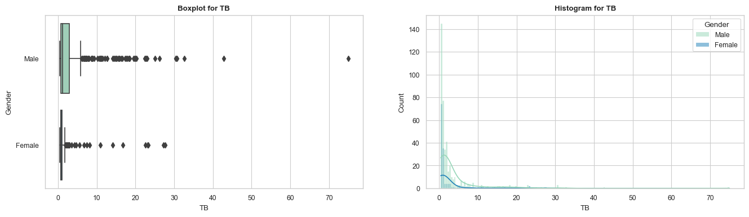
Methodology / Execution plan: Univariate analysis
Total bilirubin -> 0.4 to 75.0

Slide 8
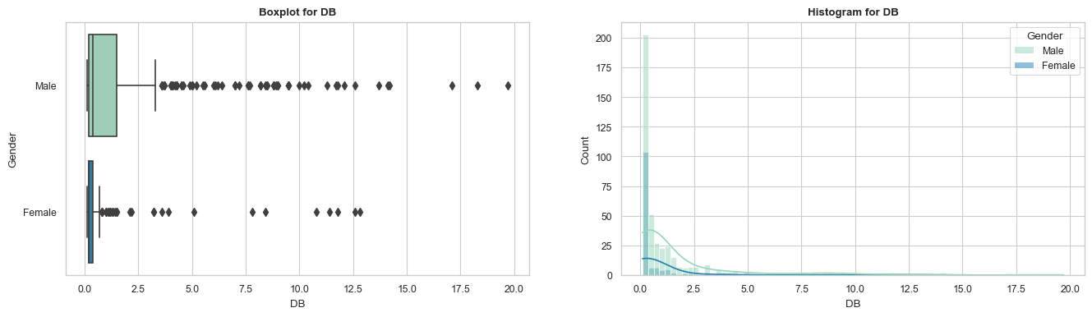
Methodology / Execution plan: Univariate analysis
Direct bilirubin -> 0.1 to 19.7

Slide 9
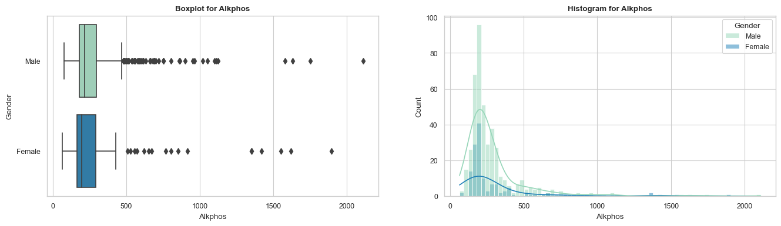
Methodology / Execution plan: Univariate analysis
Alkaline phosphatase -> 63.0 to 2110.1

Slide 10
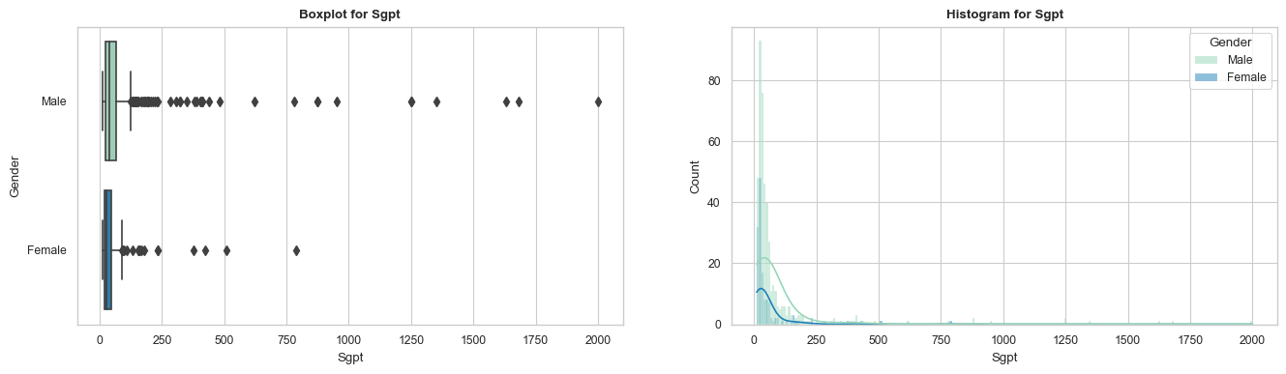
Methodology / Execution plan: Univariate analysis
Alamine aminotransferase -> 10.0 to 2000.0

Slide 11
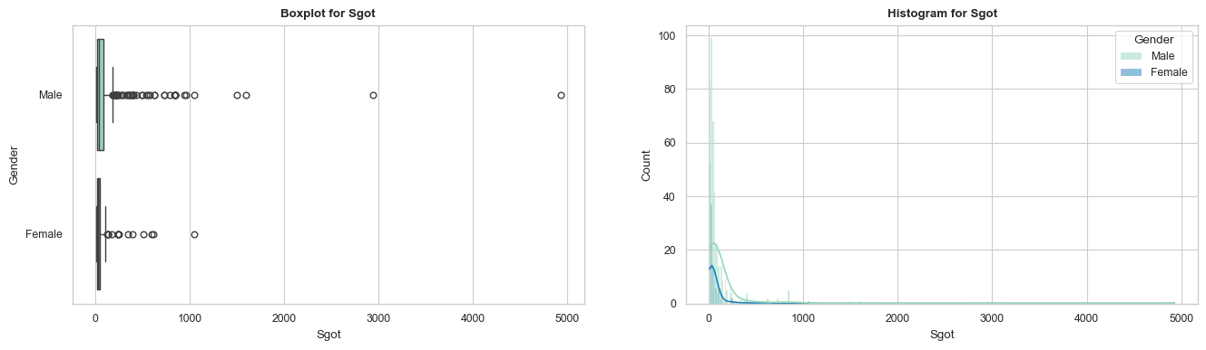
Methodology / Execution plan: Univariate analysis
Aspartate Aminotransferase -> 10.0 to 4929.0

Slide 12
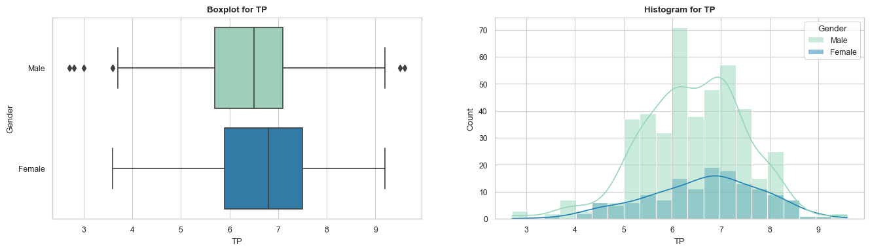
Methodology / Execution plan: Univariate analysis
Total proteins -> 2.7 to 9.6

Slide 13
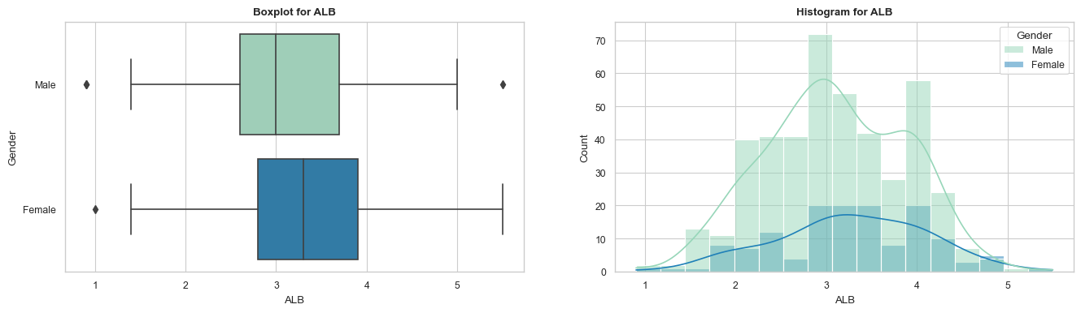
Methodology / Execution plan: Univariate analysis
Albumin -> 0.9 to 5.5

Slide 14
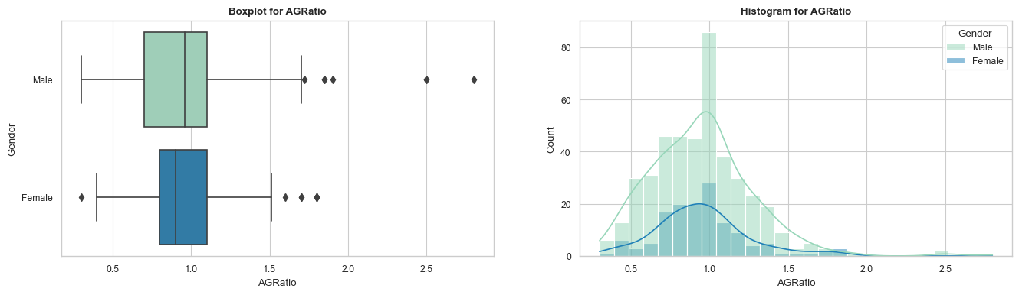
Methodology / Execution plan: Univariate analysis
Albumin & Globulin ratio -> 0.3 to 2.8

Slide 15
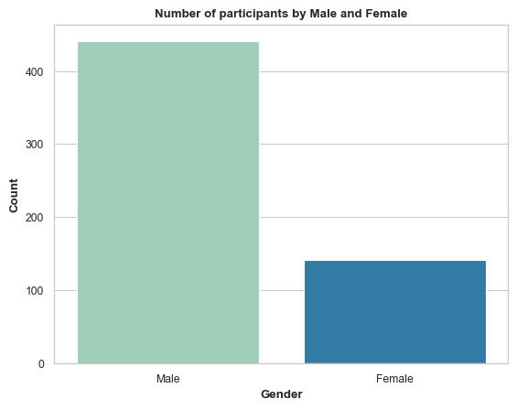
Methodology / Execution plan: Univariate analysis
Gender -> Male, Female
Note the imbalance in this feature

Slide 16
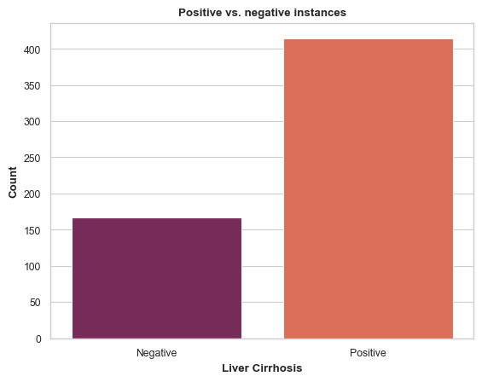
Methodology / Execution plan: Univariate analysis
Target -> Negative, Positive

Slide 17
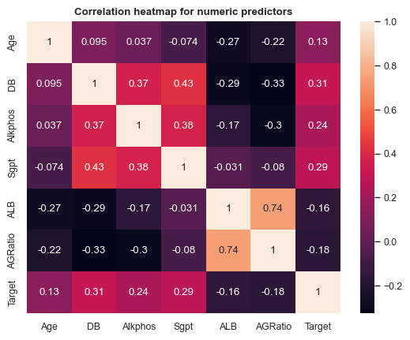
Methodology / Execution plan: Multivariate analysis
Target -> Negative, Positive
For each pair of correlated features, we drop one feature

Slide 18
Methodology / Execution plan: Data preprocessing
Missing values -> 4 values missing in Albumin & Globulin Ratio, dropped rows
Label encoding -> Gender (Female: 0, Male: 1). Target (Negative: 0, Positive: 1).
Imputing outliers -> 1.5 IQR rule used to impute outliers to ends of the distribution
Scaling -> All continuous features scaled to [-1, 1]

Slide 19
Methodology / Execution plan: Comparing metrics
Accuracy -> 71.1% for both LR and SVM.
AUC -> 0.55 for LR, 0.52 for SVM.
Note that this is the potential problem caused by imbalance in the ILPD.
Both models are only slightly better than random guesses.

Slide 20
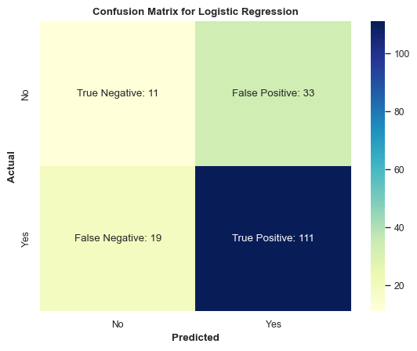
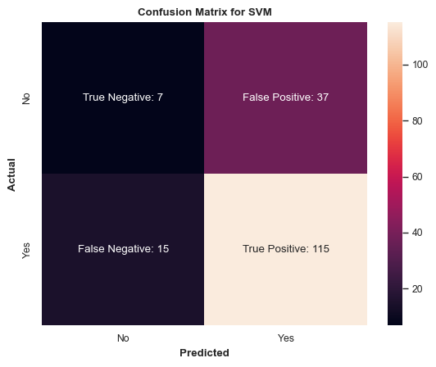
Methodology / Execution plan: Comparing metrics
After removing correlated features

Slide 21


Methodology / Execution plan: Comparing metrics
After removing correlated features

Slide 22
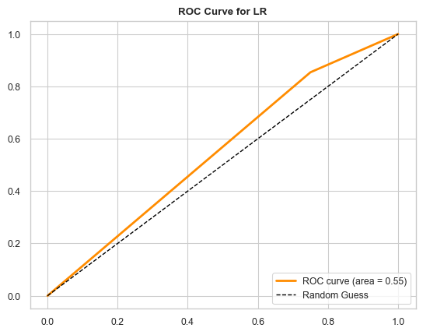
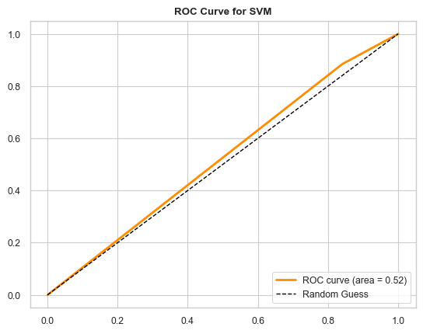
Methodology / Execution plan: Comparing metrics

Slide 23

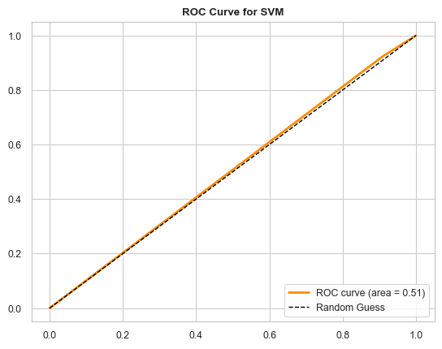
Methodology / Execution plan: Comparing metrics
After removing correlated features

Slide 24
Conclusions & further scope
Unintended effects like imbalance in features and not just the target classes can have significant consequences in clinical outcomes.
Effective study/experiment design is essential to develop equitable access to quality care for all.
Explore oversampling techniques like SMOTE to balance the dataset.
Explore SVM’s with other kernels, and possibly Decision Trees or Random Forest models.

Slide 25
Questions?

